Slide 1
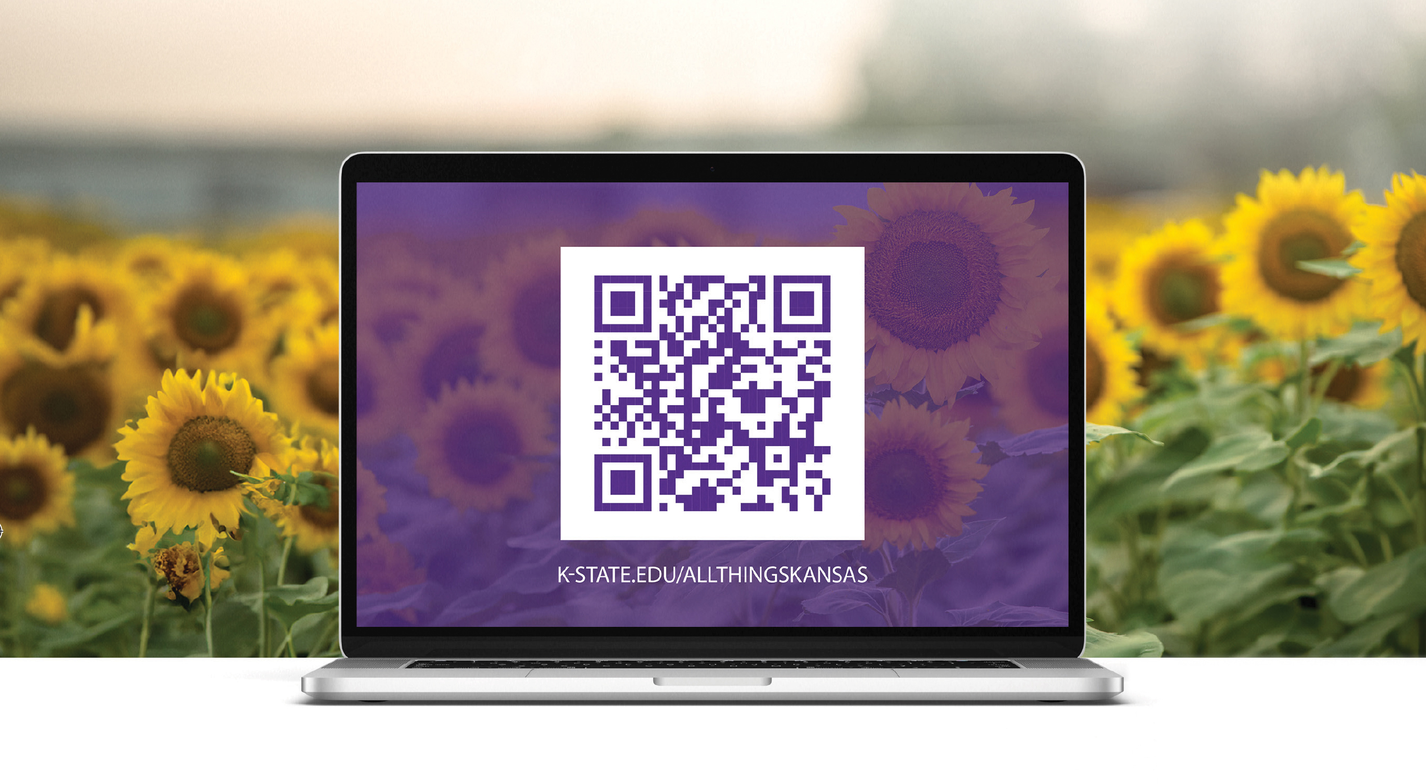

All Things Kansas
Access more than 120 national secondary sources and many state-based sources
Includes more than 30,000 data layers
Your guide to understanding all 105 counties of the Sunflower State.
k-state.edu/allthingskansas

